Slide 1
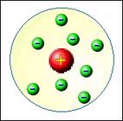
THE BOHR ATOMIC THEORY
The Rutherford Model
Known as the “nuclear model”.

Slide 2
Problems:
The nucleus has positively charged particles, which should
repel each other.
The total mass of the atom cannot be accounted for.
These can be explained by the subsequent discovery of neutrons.

Slide 3
Biggest problem:
The electron is a charged particle: when charged particles move around a central body, they give off radiation, a form of energy.
For the atom, this means that electrons in motion around the nucleus are constantly
losing energy
and can’t stay in orbit. They should spiral into the nucleus and explode.
Notes:
This can’t be explained by 19th century physics.

Slide 4
Scientists investigated this atomic radiation to find an explanation. They expected to find that atoms give off radiation at every wavelength, to show up as a rainbow.
This is called a continuous spectrum.
Instead, they found that each element has its own line spectrum.
Notes:
Do demonstration with gas discharge tubes and spectroscopes after “This is called a continuous spectrum”.

Slide 5
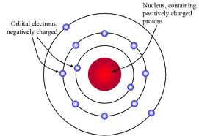
The Bohr Model of the Atom
The electrons only move in specific circular orbits.
While in these orbits, electrons do not emit energy.
When an electron changes orbits, it emits or absorbs a specific amount of energy (photon) equal to the energy difference between orbits.

Slide 6
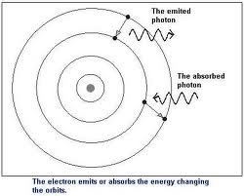
Each line of colour corresponds to an electron moving from a specific higher orbit to a specific lower orbit.
E.g. Red light is emitted when electrons move from the 3rd to the 2nd orbit.

Slide 7
Problem:
This model only worked for the hydrogen atom and its spectrum.
Bohr attempted to solve problems with the Rutherford model as well as explain the line spectrum for hydrogen. You are expected to explain how experimental work by Rutherford and Bohr contributed to the solar system model of the atom. Refer to text, p.174-179. Homework: p.180 #1, 2, 9 Read p.169-172

