Slide 1
Measuring Reaction Rates

Slide 2
The rate of a reaction represents how quickly reactants are used up, or products are produced, as a change in concentration over time: Δ[A]/ Δt, in mol/L.s. Concentration is not always the easiest thing to measure.

Slide 3
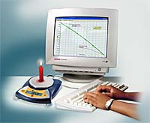
Changes in Mass
The change in mass over time of a candle burning on a balance can indicate the rate of reaction.

Slide 4
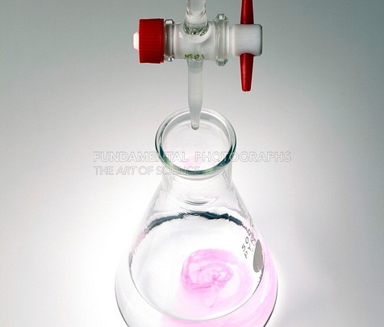
Change in pH
The pH change over time during a neutralization reaction can be measured using a pH meter.

Slide 5
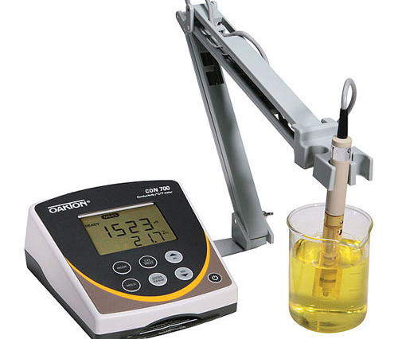
Conductivity Change
When ions are produced or used up in a chemical reaction, such as a precipitation reaction, a conductivity meter measures the change over time.

Slide 6
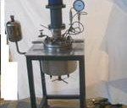
Pressure Change
If a chemical reaction produces or uses up a gas, then its rate can be measured with a pressure gauge.

Slide 7
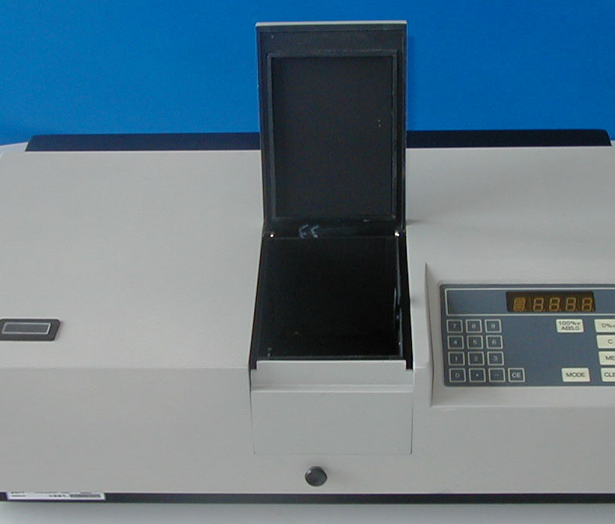
Colour Change
As chemicals react to change from one colour to a different colour, the extent of the colour change can be measured using a spectrophotometer.

Slide 8
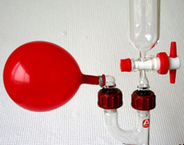
Volume Change
If the volume of gases in a chemical reaction changes, this can sometimes be measured over time.

