Slide 1
COLLISION THEORY

Slide 2
Reactions occur because of collisions.
The greater the number of collisions between molecules, the faster the reaction rate.

Slide 3
Not all collisions are effective!
Conditions for Effective Collision:
Correct orientation of molecules
Sufficient energy in the collision for bonds to form and break – activation energy, E_{a}

Slide 4
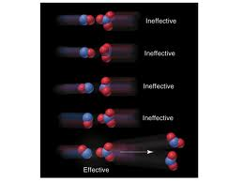
Orientation of Molecules

Slide 5
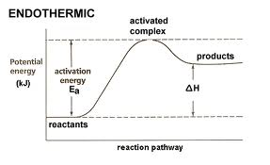
Activation Energy
the minimum increase in potential energy necessary for molecules in a system to react
Notes:
Show single collisions sim total energy bar, then multiple collisions sim, and discuss.

Slide 6
At any given temperature, there are some molecules that have enough energy to collide successfully. Higher temperatures provide greater total energy, so that more of the molecules have that activation energy.

Slide 7
Reactions are not instantaneous. The reactant molecules often may collide A with A rather than A with BC, and even when A collides with BC they may not have enough molecules colliding with the correct orientation and sufficient energy to end up with enough product to detect right away, and sometimes the products react and turn back into reactants quite easily.

Slide 8
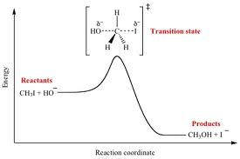
Activated Complex (or Transition State)
When the collision occurs successfully, there is a temporary structure called the activated complex: it is unstable because it has the max. E_{p} available – like balancing a ball on the tip of your finger.

Slide 9
Try this!
Consider the following reaction:
CO + NO₂ → CO₂ + NO E_{a} = 134 kJ ΔH = -226 kJ
Is this reaction endothermic or exothermic?
Draw and label a potential energy diagram.

