Slide 1
THE QUANTUM MECHANICAL MODEL OF THE ATOM
Recall that the Bohr model successfully explained the visible spectrum for hydrogen and predicted the UV and IR spectra.
Major Problem: only works for H
Is the model a coincidence, or an oversimplification?

Slide 2
The quantum mechanical model (QM model) uses the work of a number of scientists, such as Max Planck, Gustav Kirchhoff, Albert Einstein, Heinrich Hertz; therefore, it is not named after any one scientist.
Concepts:
Radiation energy, such as visible light, microwaves, X-rays, etc., is not infinitely varied in wavelength. Instead, it is produced in small packages of finite, specific amounts or “quanta” called photons. See p.169-170.

Slide 3
All matter has wave behaviour.
The wavelength of a thrown baseball might be
2x10⁻³⁴ m
This is tiny compared to the size of the ball, so there is no visible effect on the ball’s motion.
An electron moving in an atom has a wavelength of 1x10⁻¹⁰ m, which is larger than the entire atom.
∴ The electron has wave-like properties.

Slide 4
Properties of Electrons
They can be moved when hit by light waves.
When you “look” at electrons, the light you use to see them changes its position.
Heisenberg uncertainty principle: since you can’t state the position of an electron, you can’t predict its pathway (orbit). You can only state the probability of finding it in a particular volume of space.
This probable space is called an orbital.

Slide 5
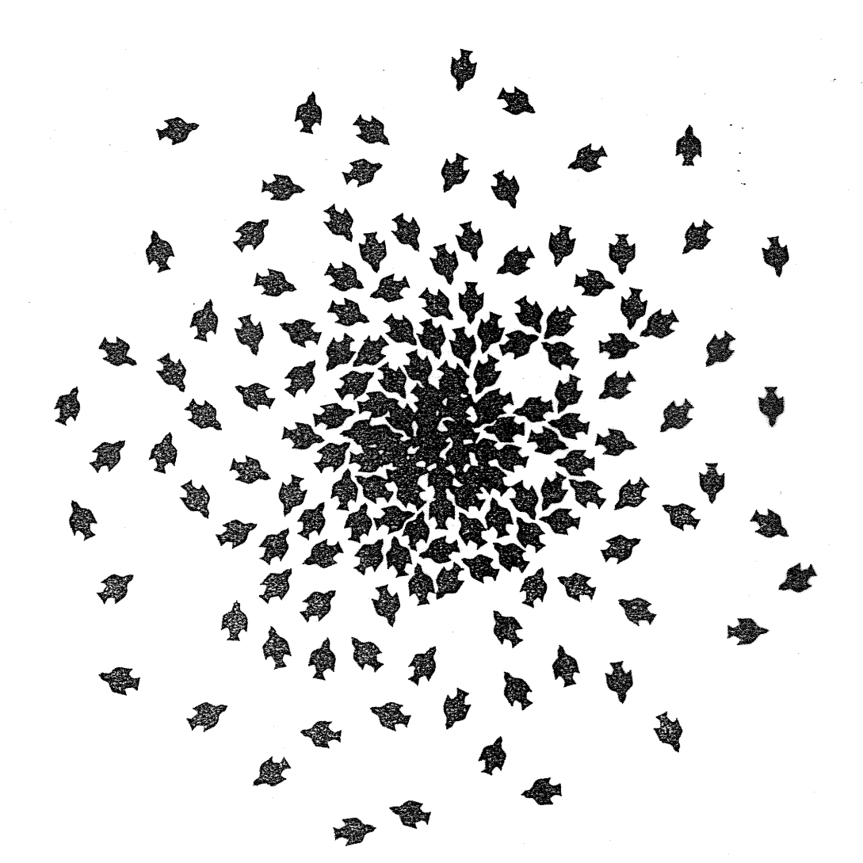
Composite picture of birds at a birdfeeder

Slide 6
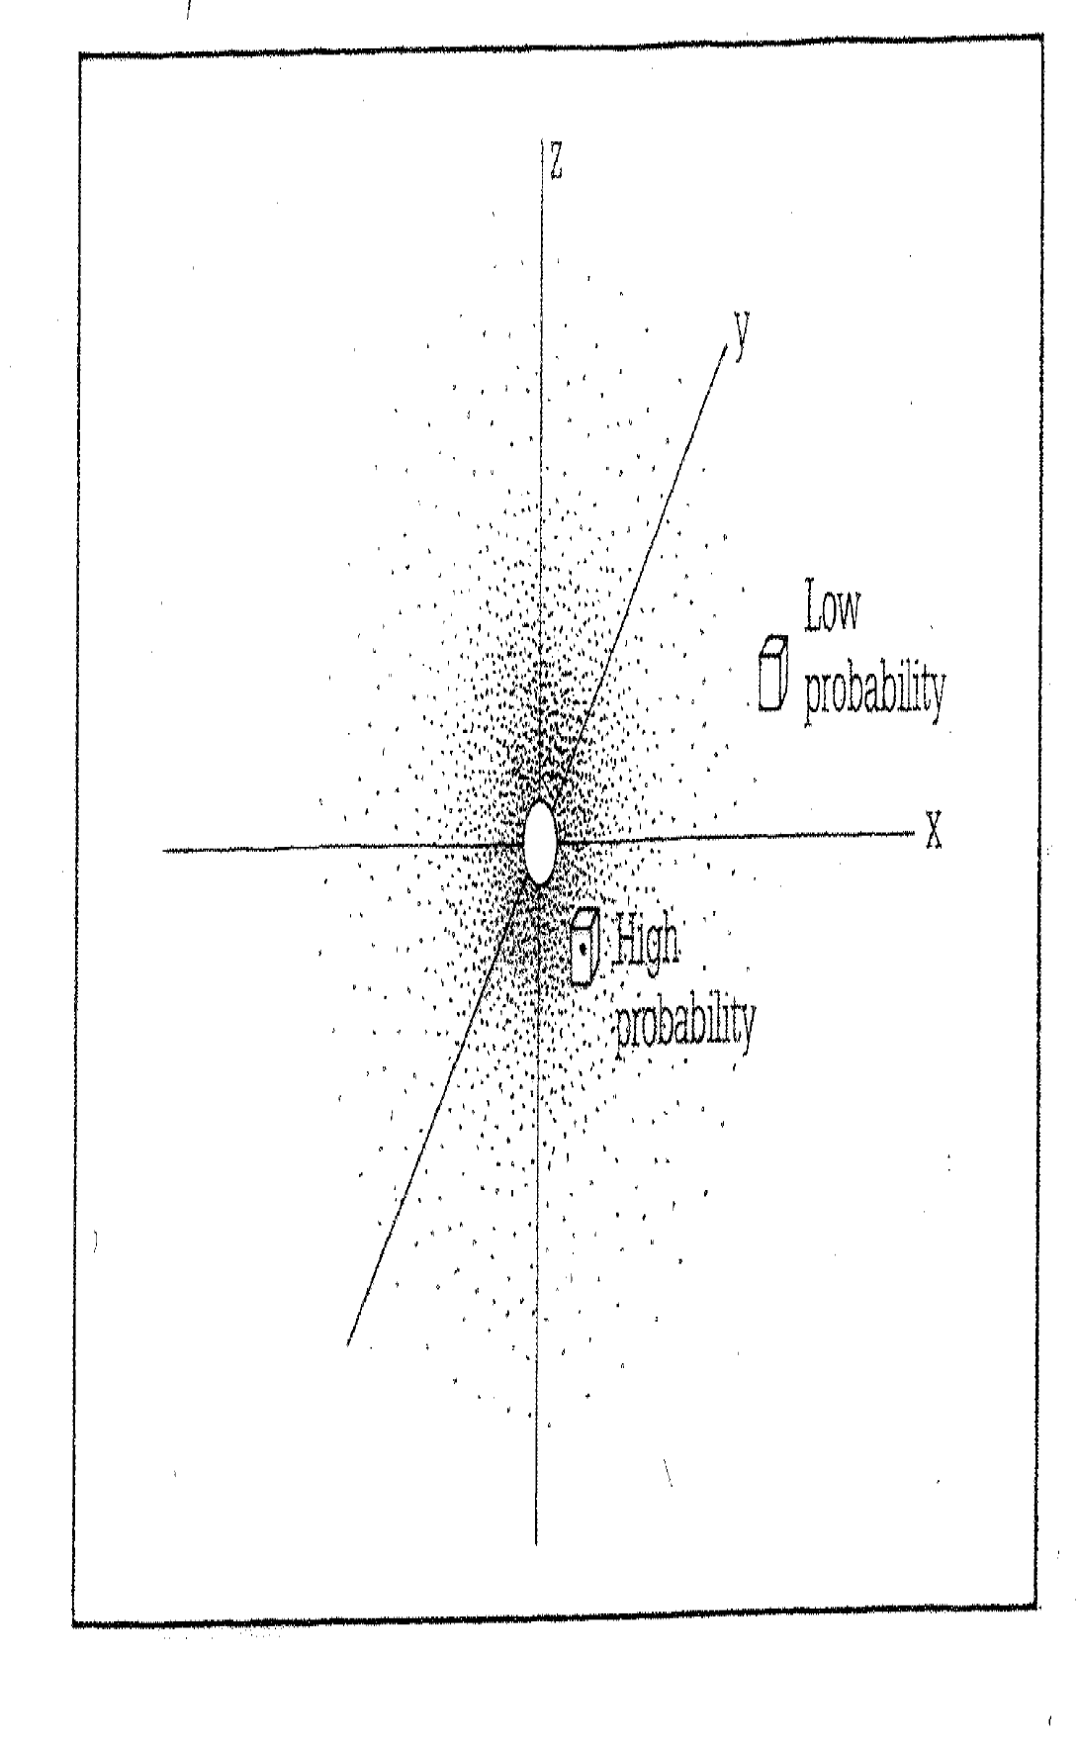
Orbital in first energy level

Slide 7
Each orbital has a specific amount of energy associated with it (like Bohr) because the wave pattern of the electrons in orbit must be standing waves, therefore, whole numbers. See p. 199, Fig. 2.
Homework: Read p.199-200, answer p.202 #2, 5. Tomorrow, we will discuss quantum numbers, so read about them on p.181-184.

