Slide 1
VALENCE BOND THEORY
Primarily developed by Linus Pauling, two-time winner of a Nobel Prize

Slide 2
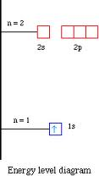
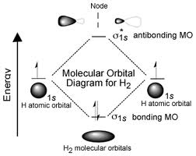
Hydrogen
H⋅ ⋅H
H:H

Slide 3
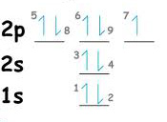
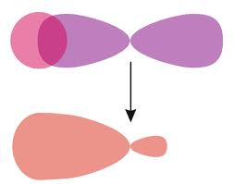
Hydrogen Fluoride
H + F → HF
..
H∙ ∙F:
..

Slide 4
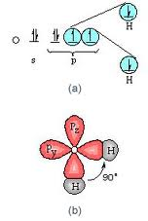
Water
The s-orbital of hydrogen overlaps with the p-orbital of oxygen.

Slide 5
A covalent bond is formed when two half-filled orbitals overlap to produce a new combined orbital containing two e⁻ of opposite spin. The bonded atoms have a lower energy than unbonded atoms.
If the energy increases when the two orbitals overlap, as with He atoms, then no bond forms.

Slide 6
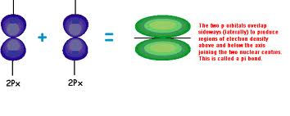
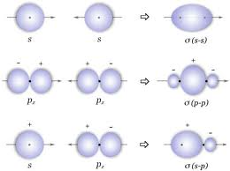
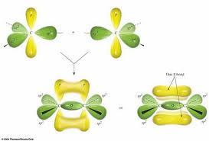
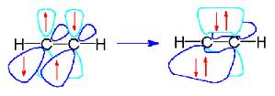
Sigma Bonds (σ)
These are single bonds, and one of the bonds in double or triple bonds.
Pi Bonds (π)
These are the second and third bonds in double or triple bonds.

